Slide 1
Modeling of Black Sea Circulation and Mixing
-
Upwelling, Floods
and Aegean Fires Triggered by Etesians
Emin Özsoy (1,2), Robinson Hordoir (3), Nathalie Toque (1), Hazem Nagy (1,4), Adil Sözer (1,5), Ozan Mert Göktürk (1,3), Sinan Çevik (6)
(1) Institute of Marine Sciences, METU, Erdemli, Mersin, Turkey
(2) İTÜ-AYBE, İstanbul, Turkey
(3) SMHI, Norrköping, Sweden
(4) Alexandria U., Alexandria, Egypt
(5) ODU-FIMS, Fatsa, Ordu, Turkey
(6) Turkish State Meteorology Service, İnebolu, Turkey
İTÜ UUBF Seminar 17 March 2016
(also VII. Atmospheric Science Symposium ATMOS 2015 İTÜ, İstanbul, 28 April 2015

Slide 2
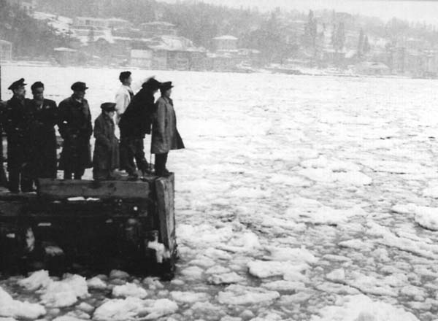
Mediterranean and Black Sea
-
regions of high climate variability
and contrasts

Slide 3
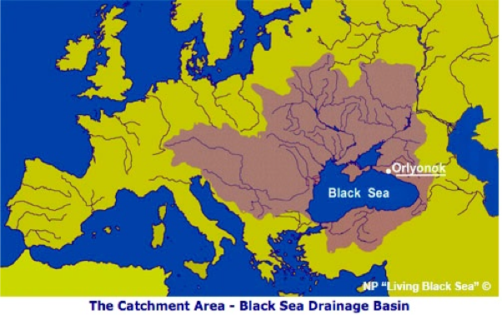
The Black Sea:
an ‘almost’ closed basin, constrained by the exchange of water at the Turkish Straits System,
catchment area covering almost half of the European continent
large rivers and land runoff carry water and pollutants into the sea
The hydrological cycle of water originating from the European-Black Sea and the Euro-Mediterranean regions is completed by the fluxes of water through the Turkish Straits System
air-sea exchange is all too significant in the climate sensitive region of seas trapped between lands - medi terra nean character

Slide 4
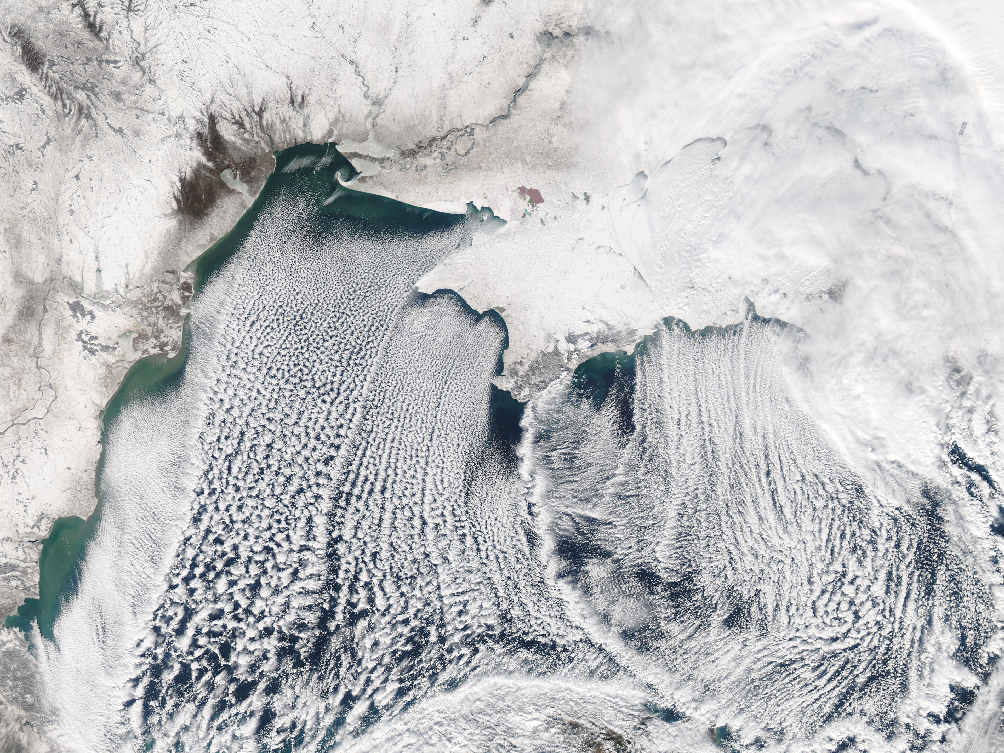
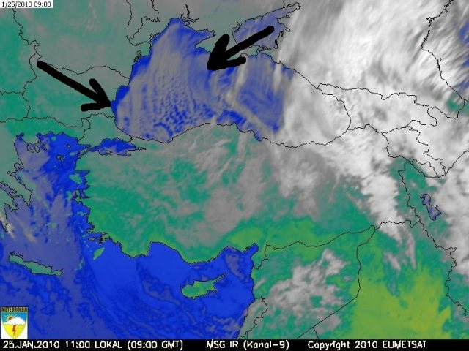
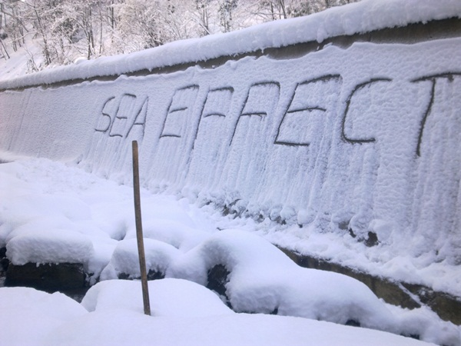
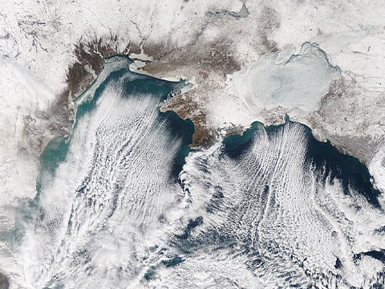
Feb 02, 2012
Ice NWS
Jan 25, 2010
Ice cover
Azov Sea
Feb 10, 2012
Ice NWS
Ice cover
Azov Sea
Wintertime moisture transport
SEA EFFECT
Cold dry winds from the north picking up
moisture from the warm Black Sea
Southward moisture transport from the Black Sea
creates snow blizzards in the absence of a storm…

Slide 5
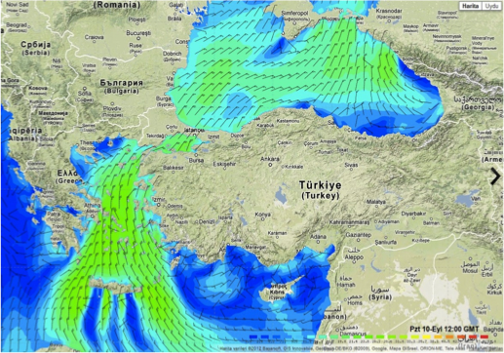
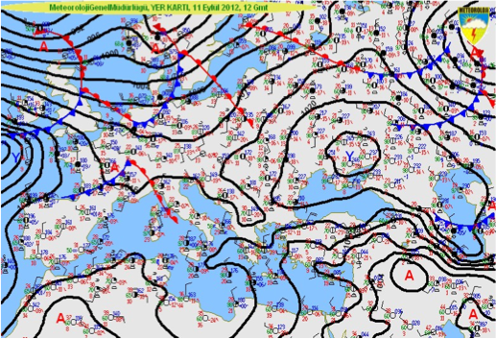
Typical summertime atmospheric circulation:
Stable situation involving
The Basra cyclonic circulation component
of the Indian Monsoon system
- antcyclonic circulation established near the
Balkans and north of Black Sea

Slide 6
GEOGRAPHY
Black sea: depth max. 2252 m, avg. 1240 m,
max zonal length 1150 km, min. meridional width 260 km at Crimea – Sinop section
Continental shelves - 25% of the total area, depth ≤ 100 m, western area and near Kerch Strait.
Steep continental slopes except near the Danube and the Kerch strait
Azov sea: depth ≤ 20 m
Kerch strait, width ≤15 km, depth ≤ 18 m, length 5 km
Bosphorus strait: width ≤ 1 km at narrows, depth max. 110 m, sill 60m, length 32 km.

Slide 7
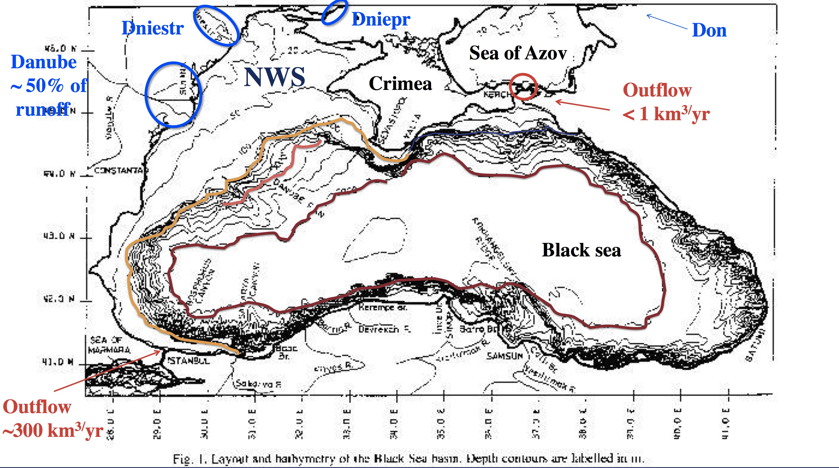
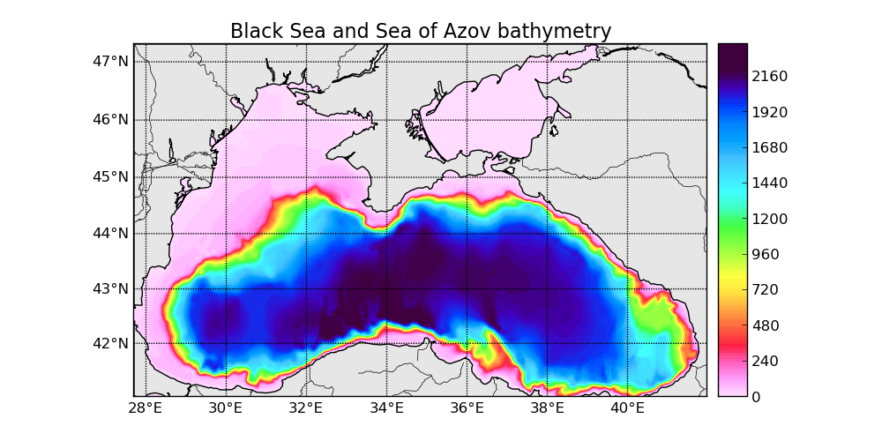

Slide 8
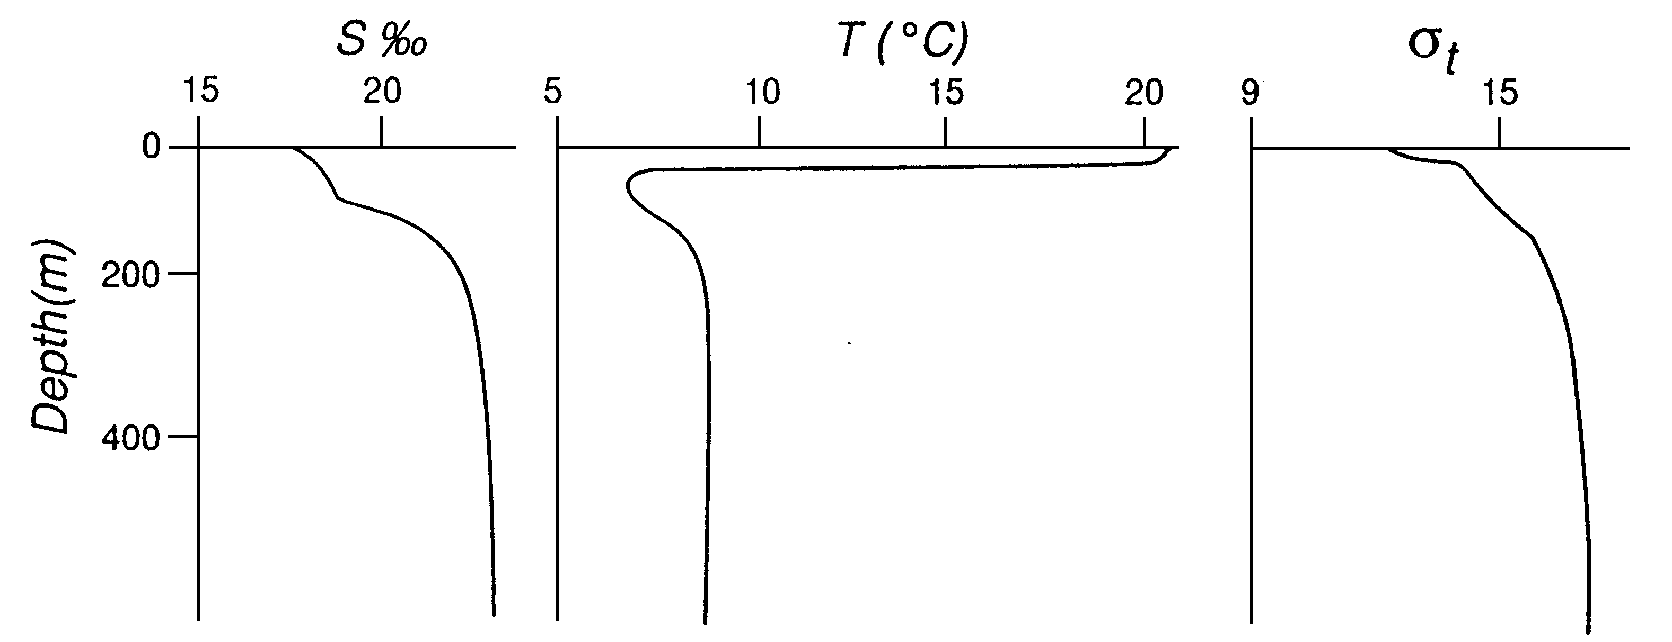
STRATIFICATION
Typical profiles of temperature, salinity and density show a well-pronounced permanent pycnocline, which is situated at a depth of 150-300m. Density stratification is determined mainly by salinity. The deep-sea salinity is near 22.5 ppt against 18-18.5 ppt on the surface. Temperature input significant in the upper layer where is observed a distinctive feature of the Black Sea thermal stratification – the cold intermediate layer. SST is varying seasonally from 8°C up to 30°C. Deep temperature is about 8.5°C. The internal Rossby radius is about 25 km in the deep-sea area.
IMPORTANCE OF JEBAR EFFECT !
Both stratification and shelf topo
Centered at 100m !

Slide 9
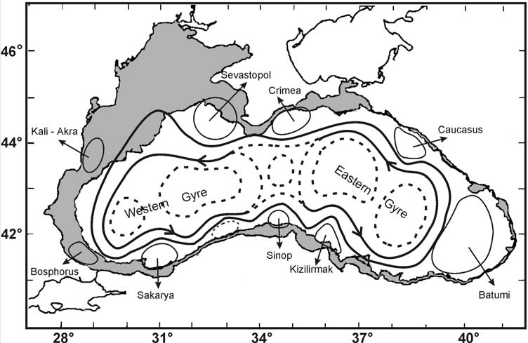
The Black Sea surface circulation
The schematic diagram for the main features of the upper layer circulation derived from synthesis of past hydrographic studies prior to 1990

Slide 10
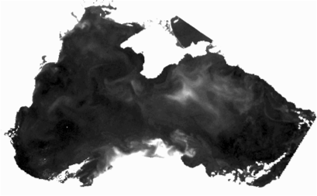
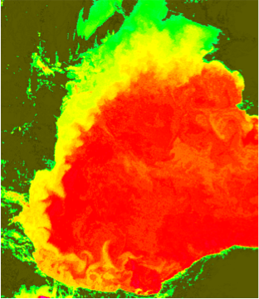
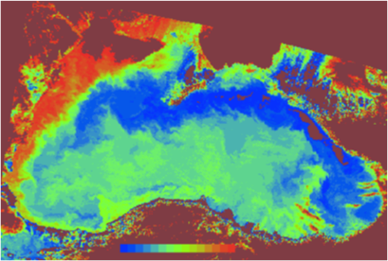
Intense meso-scales:
upwelling systems
boundary currents
jets and eddies
winter ice cover in the north
entire basin ROFI
‘regions of fresh water influence’
sensitive climate
sensitive ecosystem
refs: Sur et al., 1996,
Özsoy and Ünlüata, 1997, 1998
upwellings
buoyancy driven
boundary currents
topographic interactions of
boundary currents

Slide 11
The circulation of the Black Sea is
mainly wind an buoyancy driven,
and surface intensified, with a
strong stratification that has evolved
by great amounts of fresh water
supplied by rivers such as the
Danube, Dniepr, Dniester in the
northwest, which form a coastal flow
of low salinity water along with
the rim current.
There is a strong horizontal
Stratification across the front,
both due to salinity, as well as
temperature in the winter
months when ice is formed in the
northwest.
FEB28, 1982
winter sst
shelf flow

Slide 12
winter sst
shelf flow
and upwelling

Slide 13
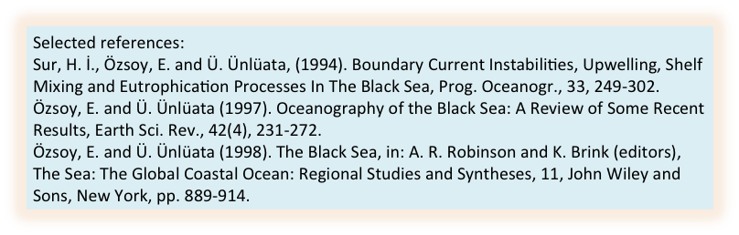
A boundary or rim current runs cyclonically around the Black Sea, and the jet currents along the southwest often become unstable, triggered by the sharp topographical changes.
Sur et al. 1996
meandering
current
eastward
propagation
speed
~ 10 km/day
upwelling
topographic interactions of
the boundary current

Slide 14
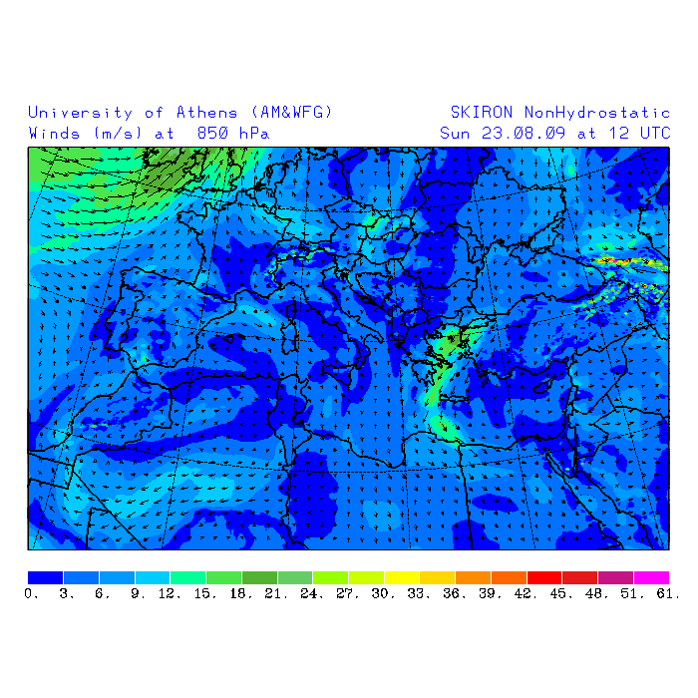
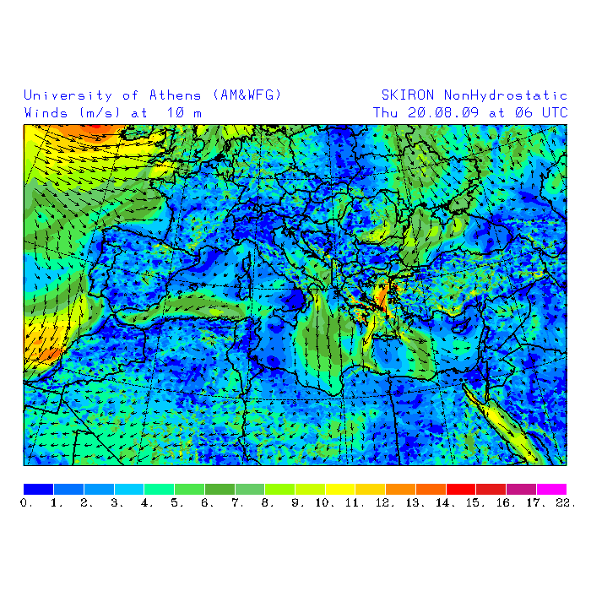
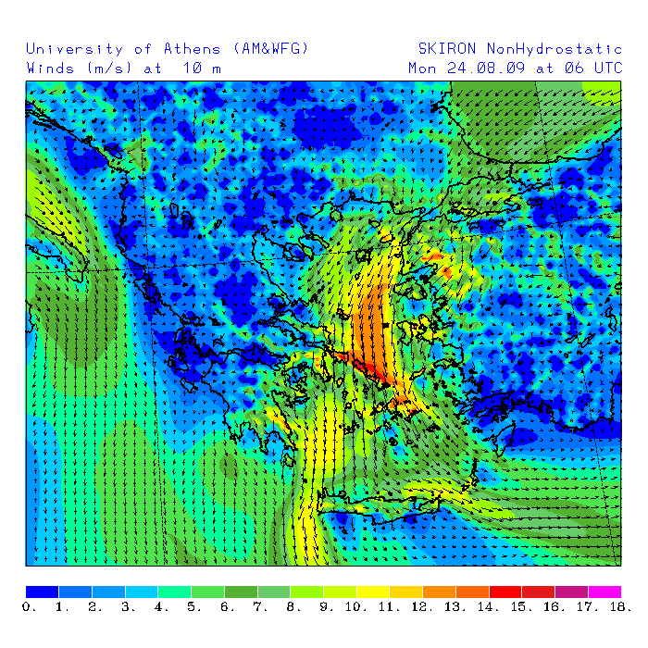
SKIRON Athens
forecast winds
August 2009
Surface winds on
on 18 Sep 2012
(metuwrf forecast)

Slide 15
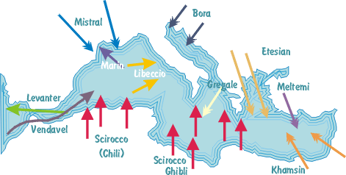
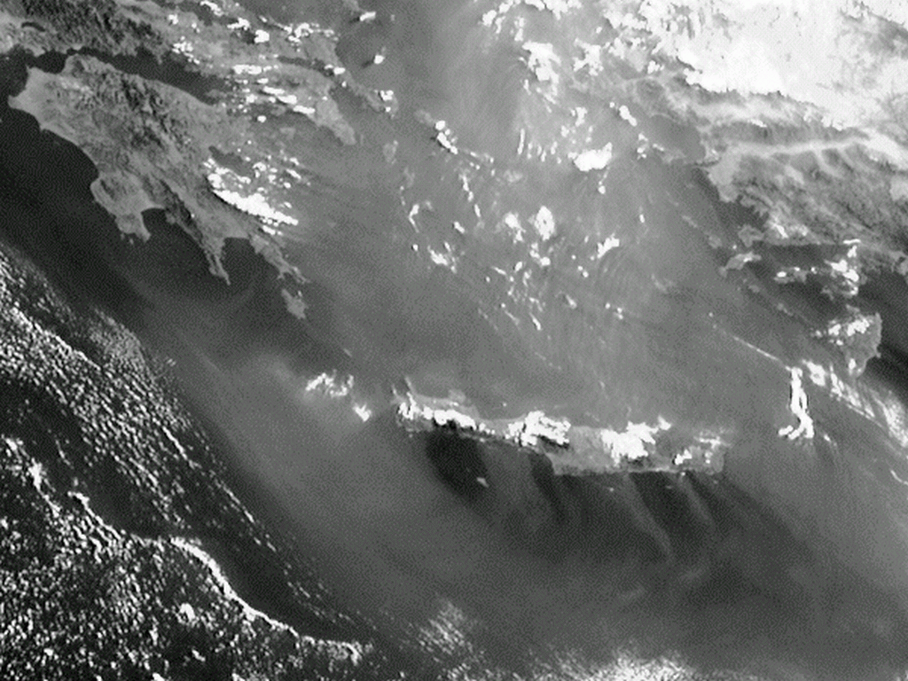

Slide 16
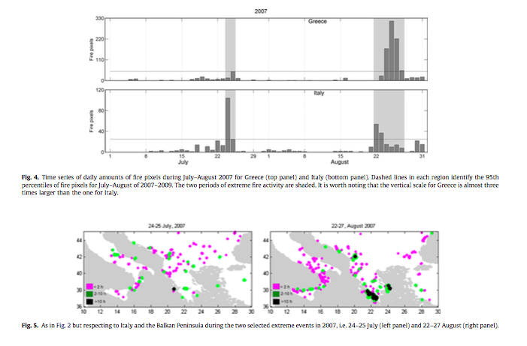

Slide 17
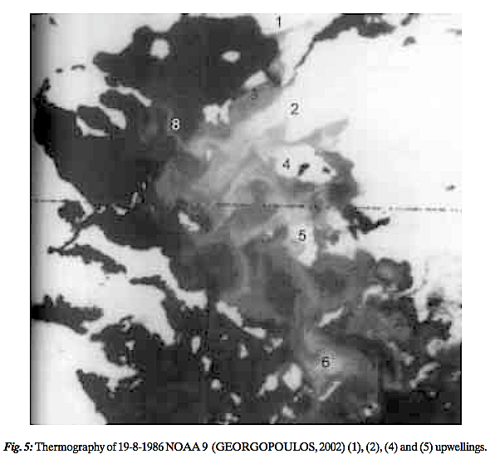
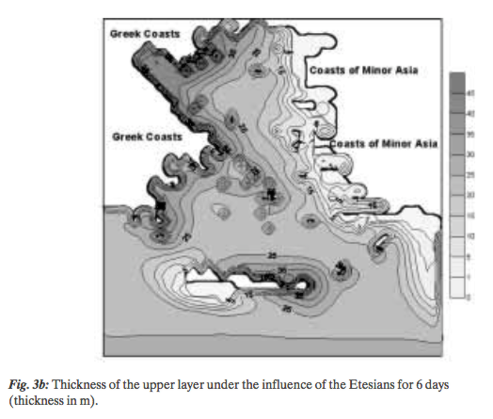
Upwellings in the Aegean Sea
(Savvidis et al., 2004)

Slide 18
72hr accumulated
Precipitation
on 18 Sep 2012
(metuwrf forecast)
72 hr surface winds
and relative humidity
on 18 Sep 2012
(metuwrf forecast)

Slide 19
Satellite SST
on 12 Sep 2012
Skiron winds
on 12 Sep 2012

Slide 20
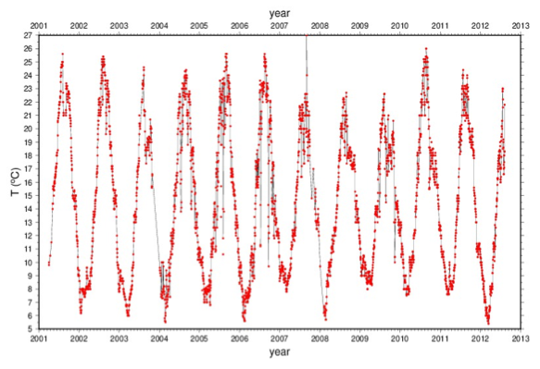
İNEBOLU Sea Surface Temperature SST

Slide 21
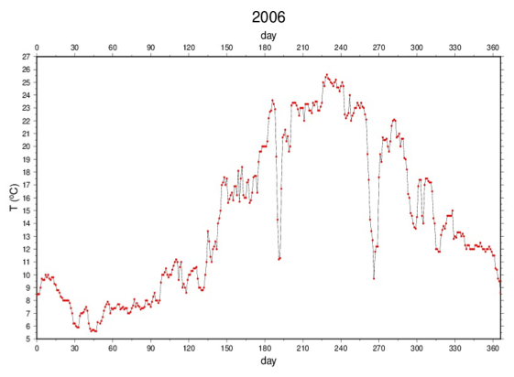
İNEBOLU Sea Surface Temperature SST

Slide 22
SST time series
At İnebolu
High-pass
filtered
SST time series
at İnebolu
Northeasterlies
create upwelling
along the southwest
Black Sea coast
Near İnebolu !
İnebolu winds
red dots – original data
black – low pass filtered
Rotated 40° to align with
the coast
U -alongshore
V -crosshore
V
U
İnebolu SST
blue- observed at İnebolu
black – ECMWF data base

Slide 23
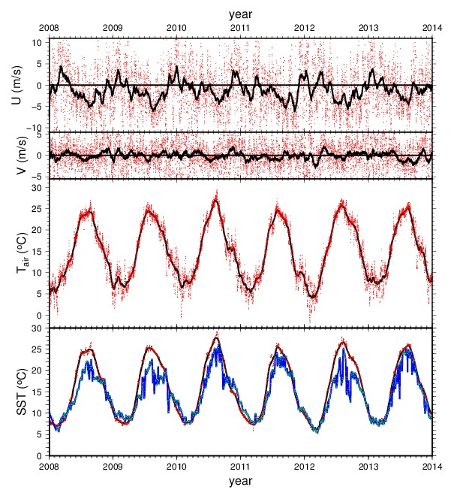
İnebolu winds
low pass filtered
aligned with
the coast
U -alongshore
V -crosshore
same pattern
repeated
2008-2014 !
ECMWF SST
near inebolu
İnebolu SST
blue – observed
black – ECMWF

Slide 24
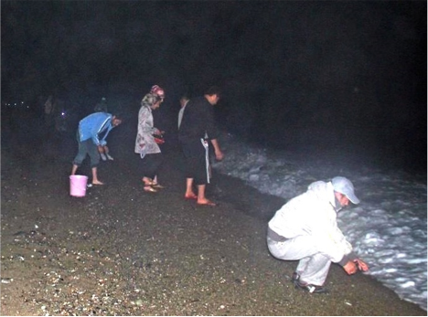
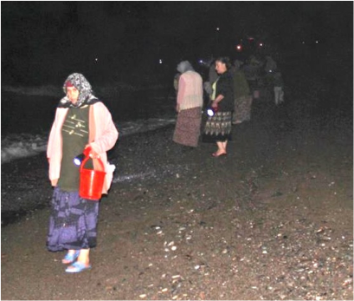
Photos Sinan Çevik

Slide 25
Dizzying fish by the upwelling collected by the people of İnebolu !
Photos Sinan Çevik

Slide 26
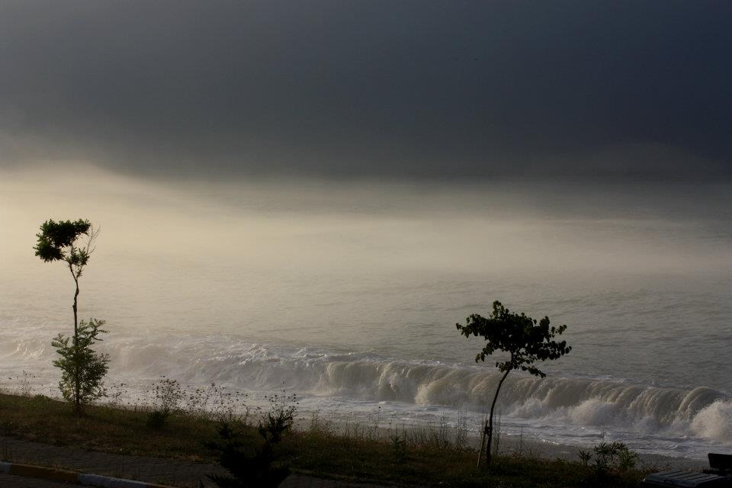
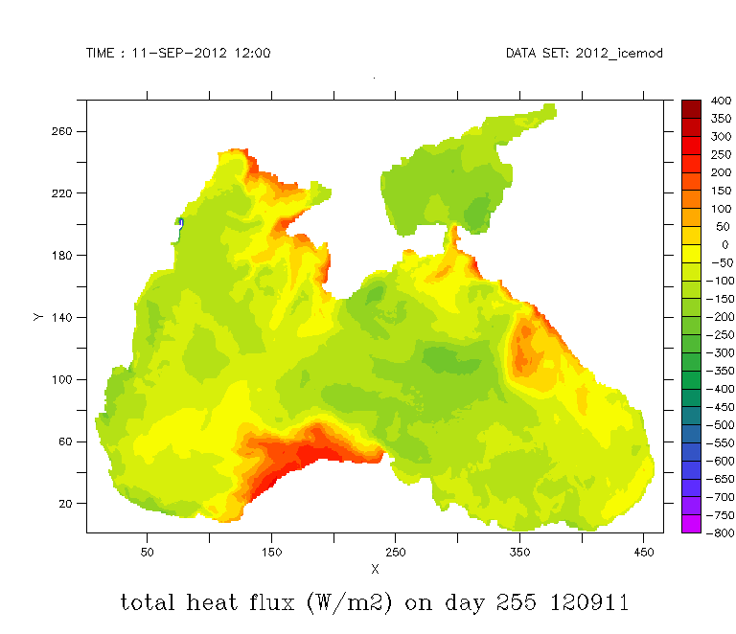
‘Marine Layer’ (atmospheric inversion) at İnebolu coastal upwelling area, Black Sea
Photo Sinan Çevik

